Slide 1
Financial Assistance Case Metrics
Saturday, June 27, 2020
Regine N. Denerville
Data Analytics - SQL Capstone

Slide 2
Introduction
Disclaimer: All data has been anonymized to protect patient confidential information.
Background of Data: This data is from a daily raw Epic visits file specially created for reports by our Consultant called Huron. It is full of visits from Patient Workqueues. However, I narrowed down the data specifically self-pay inpatient visits that were expected to be screened by Financial Counselors at Bellevue in their Financial Assistance Workqueue. Financial Counselors work on these visits from a workqueue which list all patients In-House and discharged. This data will focus on discharged visits.
Case: The Revenue Cycle Patent Access Teams use this data to identify self-pay patients that have been screened for Insurance, H+H Options, NYC Cares or other available programs. Financial Counselors are required to open a case for every self-pay patient that is on their workqueue to ensure that we are able to capture the best possible way for payment of services.
Business Problem: To identify self-pay visits that have been screened by Financial Counselor identifying cases created; how quickly visits have been screened by Discharge date, which programs were patients placed on and how many visits were not screened.

Slide 3

Analysis
This metric is a successful metric because all the data is related to one out of many similar outcomes which have been proven in previous epic reports. I identified all the tables that would be useful and created a relationship with each column to produce results by separating each table with similar data. I created a Patient table, Patient Appointment table, Patient Finance and Patient Visit.
The context of the question was to identify when a patient is interviewed and what the outcome of that interview. The business application gathers this information to identify patients that have been In-House without insurance and how Financial Counselors assist these uninsured patients.
I knew the data could answer the business statement because I’ve acquired this data from a Hospital Visits file created by Epic, the source of the data. Due to PHI policies, I’ve anonymized patients first name, last, visit number and Medical record number using Mockaroo.com

Slide 4

Insights into data and Approach
I had to take one large file and break it into four files to create four tables; patient table, patient_appt, patient_finance, patient_visit
A couple of rows were found with data as “null” but this was expected, because this determines visits that were possibly not screened by a financial counselor. There were also duplicates of patient names located.
Each variable in one column defines an action, date, or count. Each row is a visit that was discharged.
Each table consists of different types such as integers, dates, characters varying and money.
The common relationship between the patient table and patient_visit table where they both share visit numbers.
Issues I faced, I found that when I originally created tables a few column variables needed to be altered in order for queries to give an outcome. Dates must have a ‘date’ variable and Charges need to have a ‘money’ variable.
I spent a lot of time on queries that gave me errors; small things such as the placement of the “<“ and the “=“.
FILE

Slide 5
Project – Artifacts
New Files
Original File: BE_Hospital_Visits_FE_Epic.csv (size 70,000 kb)
Filtered based on Discharged Visits, Self-Pay financial class, patient class as inpatient, newborn and inpatient psych
Patient.csv
Patient_appt.csv
Patient_finance.csv
Patient_visit.csv

Slide 6
Project - Scripts
Patient Table Script
Patient Appointment Table Script
-- Table: public.patient
-- DROP TABLE public.patient;
CREATE TABLE public.patient
(
pt_id bigint NOT NULL DEFAULT nextval('patient_pt_id_seq'::regclass),
visit_number bigint,
patient_last_name character varying COLLATE pg_catalog."default",
patient_first_name character varying COLLATE pg_catalog."default",
patient_medical_record_number bigint,
CONSTRAINT patient_pkey PRIMARY KEY (pt_id)
)
TABLESPACE pg_default;
ALTER TABLE public.patient
OWNER to postgres;
-- Table: public.patient_appt
-- DROP TABLE public.patient_appt;
CREATE TABLE public.patient_appt
(
appt_id bigint NOT NULL DEFAULT nextval('patient_appt_appt_id_seq'::regclass),
appointment_service_code bigint,
appointment_service_description character varying COLLATE pg_catalog."default",
admit_description character varying COLLATE pg_catalog."default",
visit_description character varying COLLATE pg_catalog."default",
CONSTRAINT patient_appt_pkey PRIMARY KEY (appt_id)
)
TABLESPACE pg_default;
ALTER TABLE public.patient_appt
OWNER to postgres;

Slide 7
Project - Scripts
Patient Finance Table Script
Patient Visit Table Script
-- Table: public.patient_finance
-- DROP TABLE public.patient_finance;
CREATE TABLE public.patient_finance
(
pt_fa_id bigint NOT NULL DEFAULT nextval('patient_finance_pt_fa_id_seq'::regclass),
financial_class_description character varying COLLATE pg_catalog."default",
fa_program_tracker character varying COLLATE pg_catalog."default",
fa_program_tracker_status character varying COLLATE pg_catalog."default",
fa_tracker_status_date_change date,
fa_case_status character varying COLLATE pg_catalog."default",
fa_flags character varying COLLATE pg_catalog."default",
case_creation_date date,
case_close_date character varying COLLATE pg_catalog."default",
total_account_charges money,
selfpay_checkbox character(1) COLLATE pg_catalog."default",
patient_medical_record_number bigint,
CONSTRAINT patient_finance_pkey PRIMARY KEY (pt_fa_id)
)
TABLESPACE pg_default;
ALTER TABLE public.patient_finance
OWNER to postgres;
-- Table: public.patient_visit
-- DROP TABLE public.patient_visit;
CREATE TABLE public.patient_visit
(
id bigint NOT NULL DEFAULT nextval('patient_visit_id_seq'::regclass),
location character varying COLLATE pg_catalog."default",
admit_date date,
discharge_date date,
patient_type_code bigint,
patient_type_description character varying COLLATE pg_catalog."default",
visit_number bigint,
CONSTRAINT patient_visit_pkey PRIMARY KEY (id)
)
TABLESPACE pg_default;
ALTER TABLE public.patient_visit
OWNER to postgres;

Slide 8
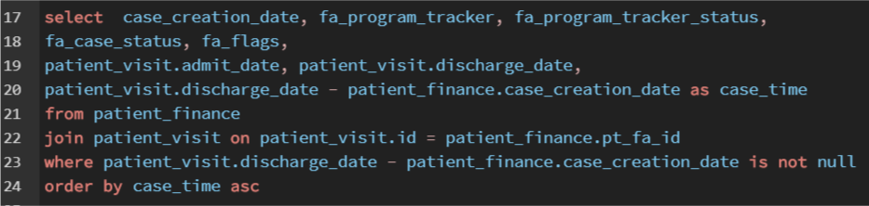
Project – Query 1
Identify visits with cases created

Slide 9
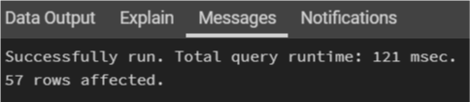
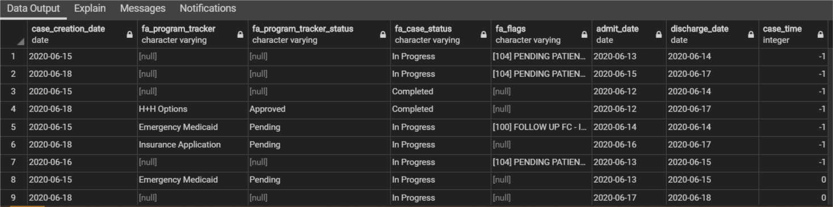
Query 1 Outcome
I was able to get an outcome of 57 visits found with cases created.

Slide 10


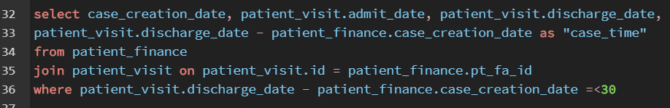

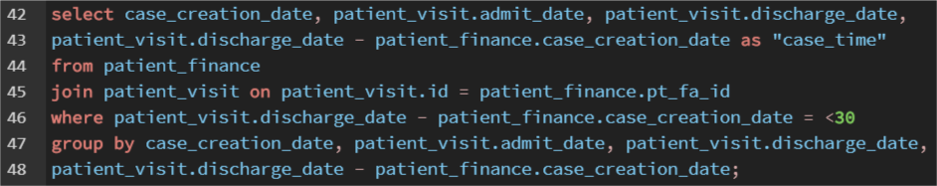
Project – Query 2
Identify visits with cases created within less than 30 days.
I ran into some errors as shown below…

Slide 11
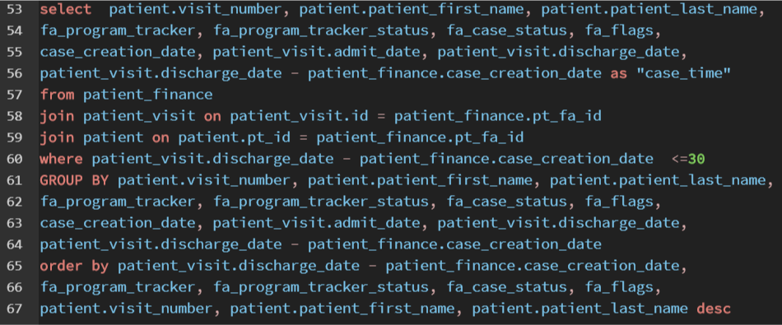
Project - Query 2 corrected
After many trials, I was able to find a successful script where I was able to identify 43 rows with cases created less than or equal to 30 days from the discharge date; Indicating that 43 patients have seen a Financial Counselor for Financial Assistance.

Slide 12

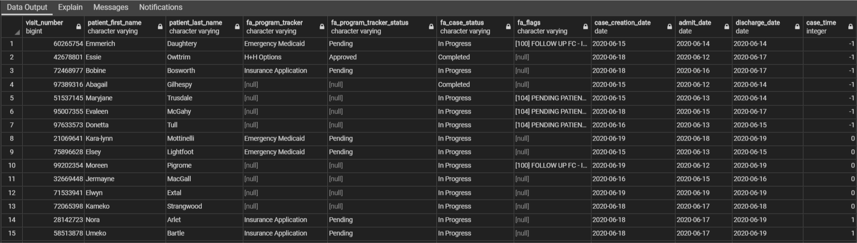
Query 2 Outcome
11 columns and 43 rows were found with cases less than or equal to 30 days from the discharge date; indicating that these patients have seen a Financial Counselor for Financial Assistance. We choose 30 days because a patients eligibility for insurance can change within 30 days or less.
These visits would be considered as Complete.

Slide 13
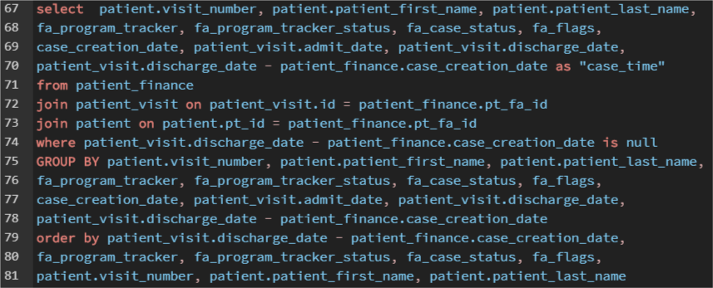
Project – Query 3
Identify visits without any cases created.

Slide 14

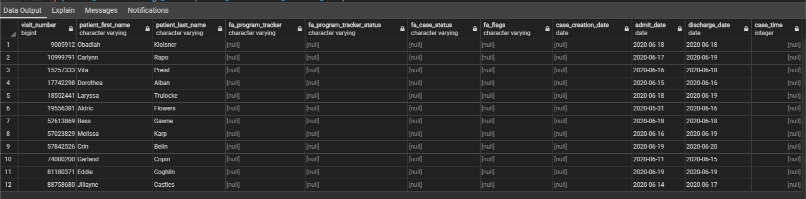
Query 3 Outcome
11 columns and 12 rows were found without cases created; indicating that these patients have not seen a Financial Counselor for Financial Assistance.
These visits would be considered In-Complete.

Slide 15




Project – ER Diagram
pt_id (PK)
visit_number
patient_last_name
patient_first_name
patient_medical_record_number
appt_id (PK)
appointment_service_code
appointment_service_description
admit_description
visit_description
fa_program_tracker_status
pt_fa_id (PK)
financial_class_description
fa_program_tracker
fa_tracker_status_date_change
fa_case_status
fa_flags
case_creation_date
case_close_date
total_account_charges
selfpay_checkbox
patient_medical_record_number
id (PK)
location
admit_date
discharge_date
patient_type_code
patient_type_description
visit_number
patient
patient_visit
Patient_appt
Patient_finance

Slide 16


Conclusion
Errors are natural, don’t spend too much time on errors, try going simple then allow the query to grow from there.
There was a total of 69 visits
57 visits were found with a case created
43 visits had cases created less than 30 days from the discharge date. These accounts would be considered Complete.
12 visits did not have any cases created, indicating that these visits are In-Complete.
Our Patient Access team uses this data to determine how many cases have been created by the discharge date, because it tells us where we can improve on in any specific service area. We can also use this data to see what programs were in created for each case created, telling us what most of our self-pay patients are eligible for to pay for their visit.

